Slide 1




Rascal: Rendezvous and Proximity Operations
Team Bravo
Jennifer Babb
Bryant Gaume
Tom Moline
Tyler Olson
Nate Richard
First Semester Presentation
December 3, 2013

Slide 2
Group Organization
Project Overview
Mission Success Criteria
Design Constraints
Mission Architecture
CONOPS
Risk Assessment
Schedule

Slide 3
Group Organization
Group Member | Position
Jennifer Babb | Structures Engineer, Propulsion Engineer
Bryant Gaume | Structures Engineer, Propulsion Engineer
Tom Moline | Program Manager, Attitude Determination and Control Engineer
Tyler Olson | Power Engineer
Nate Richard | Communications Engineer

Slide 4
Group Organization
Project Overview
Design Constraints
Mission Architecture
CONOPS
Risk Assessment
Schedule

Slide 5
Rascal Mission Definitions
As proposed, the Rascal mission consists of a spacecraft capable of demonstrating key proximity operations.
Spacecraft proximity operations consist of orbital maneuvers made relative to a resident space object. Examples or key proximity operation terms are listed below.
Proximity operations such as these haven been tagged by NASA enabling technologies for future NASA missions.
Proximity Operation Term | Definition
Stationkeeping | Maintaining a set relative displacement between two space objects for a period of several orbits
“Escape” Maneuver | Performing an orbital maneuver that increases the relative displacement between two space objects
Rendezvous | Performing an orbital maneuver that decreases the relative displacement between two space objects within a set distance for a period of several orbits
Resident Space Object | Any satellite or space debris residing in an orbit around Earth

Slide 6
Rascal Mission Success Criteria
In order for the Rascal mission to be considered successful, it must meet the success criteria listed below.
The Rascal mission shall demonstrate:
Stationkeeping: performing correction maneuvers to remain within a 10-75 meter sphere of a resident space object for at least 5 orbits.
“Escape” Maneuver: performing an orbital maneuver that intentionally increases the final displacement of the spacecraft relative to a resident space object to at least 100 meters within 1 orbit.
Rendezvous: performing an orbital maneuver that intentionally decreases the displacement of the spacecraft relative to a resident space object to within 50 meters for at least 5 orbits.

Slide 7
Group Organization
Project Overview
Design Constraints
Mission Architecture
CONOPS
Risk Assessment
Schedule

Slide 8

Quick Note
CubeSats are a class of satellites defined by California Polytechnic State University (CalPoly), typically weighing less than 8 kg and coming in several sizes. A CubeSat “U” is a 10x10x10 cm cube, massing no more than 1.33 kg.
MicroSats are a more loosely defined category of spacecraft under 500 kg in mass, with no standard external interface.
MicroSat
< 500 kg
6U
8.00 kg
3U
4.00 kg
2U
2.66 kg
1U
1.33 kg

Slide 9
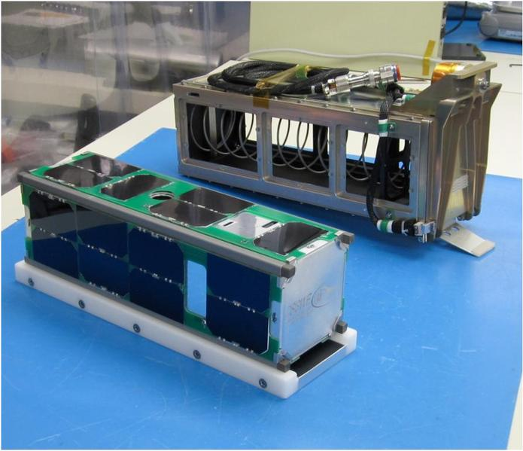
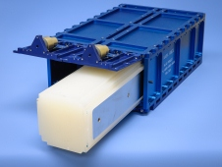
Common Spacecraft Design Constraints
Usually, the key driver of any aerospace system design is its cost and its weight.
In the case of small spacecraft design, the former plays a large role in terms of the cost associated with getting said design to orbit, while the latter place a much less significant role.
Thus, in place of weight, volume becomes a much more important constraint on any small satellite design.
This fact is directly related to the CubeSat standard described in the previous section, which has allowed for the development of deployers for spacecraft that follow it, such as the P-POD and NLAS Deployers.
Other important design constraints include mission operation time and mission success verification.
Each of these design constraints will be discussed in detail on the following slides.

Slide 10
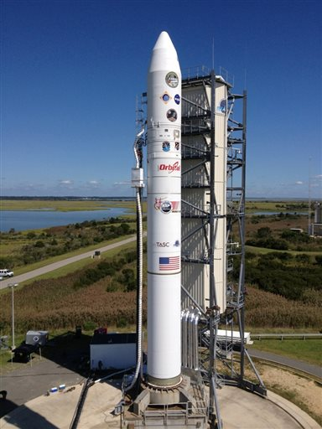
Key Design Parameters: Cost
One of the greatest limits on the scope and success of any spacecraft mission is cost, specifically, the cost of getting a spacecraft to orbit.
Launch costs alone can range from $6 million for microsatellites to $500,000 for CubeSats
However, for satellites that fall under the CubeSat category, a NASA program exists that finds and subsequently pays for launch spots for said satellites. No such program exists for microsatellites.
Beyond launch cost, the cost associated with designing, building, and testing a CubeSat (or microsatellite, for that matter) is on the order of thousands of dollars, as opposed to the millions associated with larger, more complicated spacecraft systems.

Slide 11
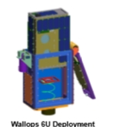
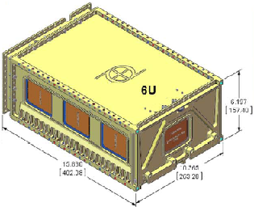
Key Design Parameters: Volume
As discussed previously, another one of the largest constraints on small spacecraft design is volume.
In the case of CubeSats, only a limited number of deployers exist.
For each of these deployers, there exists a specific volume that a spacecraft must possess in order to be properly integrated into them.
These volumes range from 0.0125 m³ for the Wallops 6U deployer to 0.00934 m³ for the Planetary Resources deployer.
Thus, any design, associated with meeting the Rascal mission success criteria must have the volume associated with one of these available deployers.

Slide 12
Key Design Parameters: Mission Lifetime
Another parameter that drives small spacecraft design is the amount of time associated with executing each of the mission success criteria.
In terms of mission operations, the longer a mission takes to run, the more likely that it is to fail before full mission success can be attained.
Thus, it is necessary to impose a limit on the time allotted for executing any given mission, as to minimize the risk associated with prolonging the mission window, as well as to reduce the amount of resources associated with operating a given mission.
In the case of the Rascal mission, a six month mission lifetime will be imposed in order to concentrate design efforts and alleviate these risks.

Slide 13
Key Design Parameters: Mission Success Verification
The final major parameter that drives small spacecraft design is the ability to verify that mission success has been achieved.
Without successful mission verification, there would be no reason to conduct the mission in the first place.
Thus, any design associated with the Rascal mission must have the ability to relay the success of meeting its mission criteria to operators on the ground.
In the case of Rascal, the data being relayed to the ground would consist of the relative distance between it and its target resident space object over the course of each orbital maneuver.

Slide 14
Group Organization
Project Overview
Design Constraints
Mission Architecture
CONOPS
Risk Assessment
Schedule

Slide 15
Relating Design Constraints to Mission Design
Each of the design constraints listed in the previous section relate directly to design decisions made in fulfilling the Rascal mission.
Cost will relate directly to the type of mission that can be flown.
Volume (not mass) will relate to the size of the mission that can be flown.
Mission lifetime will relate to the subsystems required to keep mission alive for the duration of its orbit life.
Mission success criteria will relate to the subsystems required to make the mission successful.
Mission success verification will relate to the subsystems required to relay the successful completion of the mission to the ground.

Slide 16

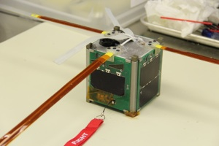

Mission Architecture: Cost/Experience Based
Based on the relatively high costs associated with launch any non-CubeSat sized spacecraft, as well as the time and resources required to design, build, and test such a system, it is absolutely necessary to limit mission design to a CubeSat architecture.

Slide 17
Mission Architecture: Cost/Experience Based (2)

Slide 18
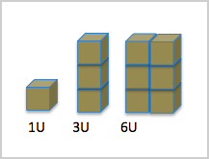
Mission Architecture: Volume Based
Since the mission architecture will fit the CubeSat standard, its launch will rely on it being able to integrate into one of the currently available CubeSat deployers.
This means that a 6U volume is the largest volume that the spacecraft can attain will still being able to meet this constraint.
It also means that a deployer must be selected for which the design of the mission will hinge upon, as each different deployer has different dimensional, structural, and electrical constraints associated with its use.

Slide 19
Mission Architecture: Success Verification Based
Based on the mission success criteria and the fact that mission success must be verified on the ground, it is clear that several subsystems will need to be integrated into the spacecraft that facilitate meeting these goals.
These subsystems, which will be described in slightly more detail on the following slides, consist of:
Structures: determines the layout of each subsystem of the spacecraft and ensuring that it is capable of surviving launch and the on-orbit environment
Propulsion: allows for the performance of orbital maneuvers to achieve each mission success criterion
Attitude Determination and Control: determines the location and orientation of the spacecraft and to collect data related to controlling the propulsion system.
Communications: allows for the communication of mission success to the ground and facilitating the observation of the spacecraft during its mission lifetime.
Command and Data Handling: allows for recording of mission data and the handling of data exchanges between each subsystem of the spacecraft.
Power: allows for the operation of each of the other subsystems over the course of the mission lifetime.

Slide 20
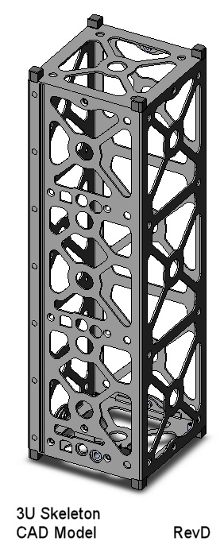
Structures Subsystem
The structure system is the backbone of the spacecraft and is used to ensure the survival of the spacecraft and to hold and contain each subsystem of the satellite.
The structure of the satellite must conform to design specifications of the deployer and the CubeSat standard architecture.
The structure will consist of two 3U CubeSats that will be attached initially but have the capability to separate during orbit, the reasons for which are discussed in the following slides.

Slide 21



Configuration Options
Full 6U satellite
Active – Passive
Active - Active

Slide 22
Configuration Option: 6U
Pros
More power available
No separation required
Cons
It is expensive to identify and track resident space objects
Launch service provider may not allow rendezvous with resident space object
More delta-v required for operations

Slide 23
Configuration Option: Active - Passive
Pros
Less Complex
Target vehicle accompanies chase vehicle to orbit
Cons
No control over vehicle
Harder to maintain relative velocities
Less redundancy

Slide 24
Configuration Option: Active - Active
Pros
Redundancy
Target vehicle accompanies chase vehicle to orbit
Replicable
Active control over target vehicle
Cons
Increased mission complexity
More expensive

Slide 25
Propulsion Subsystem
The propulsion subsystem will be capable of executing orbital maneuvers issued to it from the Attitude Determination and Control subsystem.
Potential Fuels for the propulsion subsystem consist of:
R-134a
Butane
Electric
Water
Hydrazine
Solid Propellant

Slide 26
Attitude Determination and Control Subsystem
The attitude determination and control provides a means of commanding the propulsion system to perform orbital maneuvers associated with the RFP requirements.
It provides a method to maintain the stability of the spacecraft
Methods of Attitude Determination and Control
Magnetorquer
Star/sun tracker
Accelerometers
Gyroscopes
GPS Receiver
Reaction Wheels

Slide 27
Communications Subsystem
The communication system is used to provide verification of mission objective completion to the ground.
Data that would be sent down:
Relative Distances
Relative Velocities
Spacecraft Health
There are several frequencies available for use, ranging from VHF to S-band.
The major design considerations for selecting a radio are the output power and baud rate.

Slide 28
Power Subsystem
The Power Subsystem (PWR) generates, stores and distributes power for the other spacecraft subsystems, and consists of three major components:
Electrical Power System (EPS): a component that regulates and distributes power to the rest of the spacecraft through the spacecraft bus.
Rechargeable Battery: usually attached to the EPS, the battery stores the excess power generated by the solar arrays for use during the eclipse section of the orbit and serves as the primary power source for the spacecraft.
Solar Arrays: fixed to the spacecraft’s exterior, the solar arrays recharge the battery during the sunlit section of the orbit. Some configurations can deploy panels to increase the exposed area, allowing for significantly greater power generation. Fixed-body arrays are mounted directly to the spacecraft structure and do not move, saving complexity, cost, and weight in exchange for less power generation.
Future work will include the construction of a power budget incorporating the consumption of all subsystems and generation during every phase of flight to ensure a net-positive power margin.

Slide 29
Group Organization
Project Overview
Design Constraints
Mission Architecture
CONOPS
Risk Assessment
Schedule

Slide 30
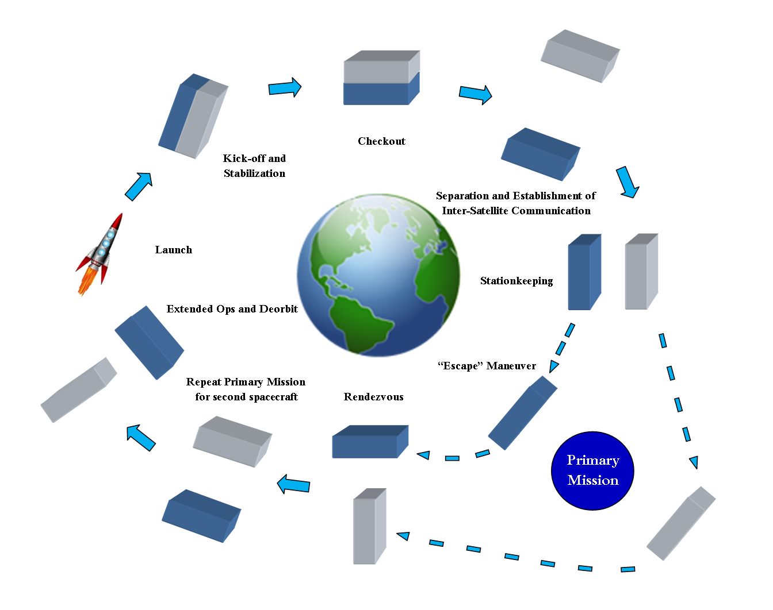

Slide 31
Group Organization
Project Overview
Design Constraints
Mission Architecture
CONOPS
Risk Assessment
Schedule

Slide 32
Risk Assessment Diagram
5
4
3
2
1
 | 1 | 2 | 3 | 4 | 5
Likelihood
Level | Definition Levels:
1 | Not Likely
2 | Low Likelihood
3 | Likely
4 | Highly Likely
5 | Near Certainty
Likelihood
Consequence
Consequences
Level | Technical | Schedule | Cost
1 | Minimal or no impact | Minimal or no impact | Minimal or no impact
2 | Minor performance Shortfall, Same approach retained | Additional activities required; able to meet key dates? | Budget increase or unit production cost<1%
3 | Moderate performance shortfall, but workarounds available | Minor schedule slip; will miss need date | Budget increase or unit production cost increase <5%
4 | Unacceptable, but workarounds available | Program critical path affected | Budget increase or unit production cost increase <10%
5 | Unacceptable, no alternatives exist | Cannot achieve key program milestone | Budget increase or unit production cost increase >10%

Slide 33
Risks
Risks
 | Risk | Likelihood | Consequences
1 | Loss of Communication | 2 | 5
2 | Collision between spacecraft | 3 | 3
3 | The spacecraft did not separate properly | 3 | 2
4 | Spacecraft unable to locate each other | 3 | 4
5 | Unable to generate enough power | 2 | 3
6 | Spacecraft separate too fast from each other | 3 | 3
7 | The spacecraft end up too far apart from each other | 3 | 4
8 | Run out of propellant before end of mission | 1 | 5
5
4
3 |  | 3 | 2 5 6 | 4 7
2 |  |  |  |  | 1
1 |  |  |  |  | 8
 | 1 | 2 | 3 | 4 | 5
Likelihood
Consequence

Slide 34
Risks
 | Risk | Likelihood | Consequences
9 | An error occurs during the integration of spacecraft components | 2 | 4
10 | Deorbits before six months | 1 | 5
11 | A spacecraft component fails on orbit | 1 | 3
12 | A leak develops on the propulsion unit | 1 | 3
13 | A failure occurs on the satellite during launch | 1 | 3
14 | Solar panels malfunction | 2 | 3
15 | Spacecraft components operate out of operational temperature range | 1 | 2
16 | Radiation damage | 1 | 2
5
4
3
2 |  |  | 14 | 9
1 |  | 15 16 | 11 12 13 |  | 10
 | 1 | 2 | 3 | 4 | 5
Likelihood
Consequence

Slide 35
Group Organization
Project Overview
Design Constraints
Mission Architecture
CONOPS
Risk Assessment
Schedule

Slide 36
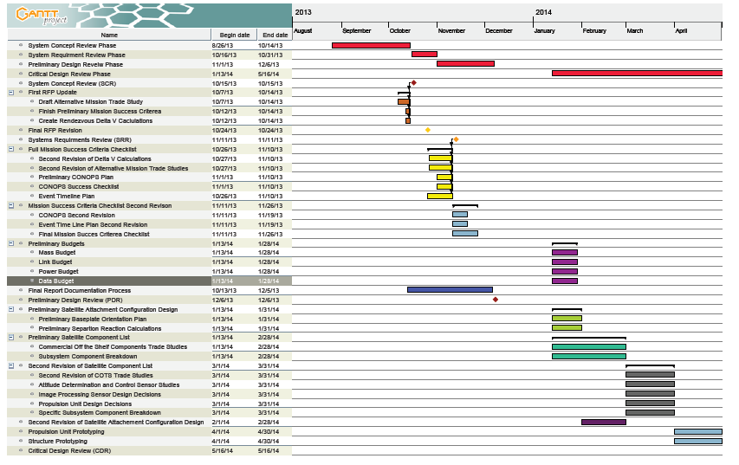

Slide 37
Questions?
Jennifer Babb
Bryant Gaume
Tom Moline
Tyler Olson
Nate Richard
First Semester Presentation
December 3, 2013

